Slide 1
GPP Exam: Zombie AI
Gonzalez De Muer Sacha
2DAE15

Slide 2
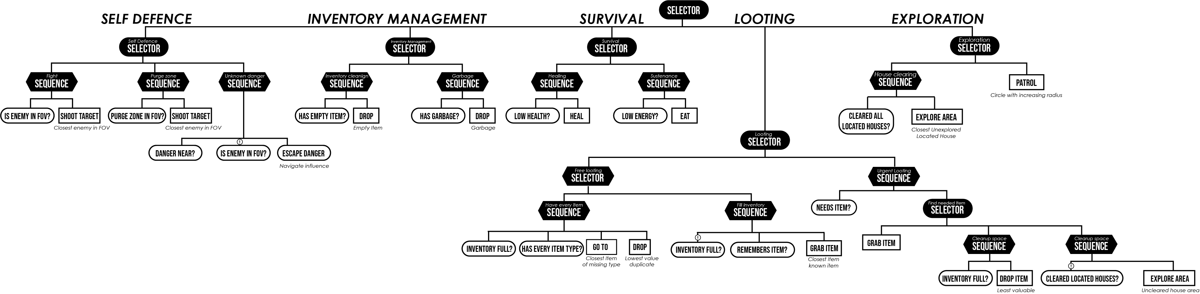
Decision Making

Slide 3
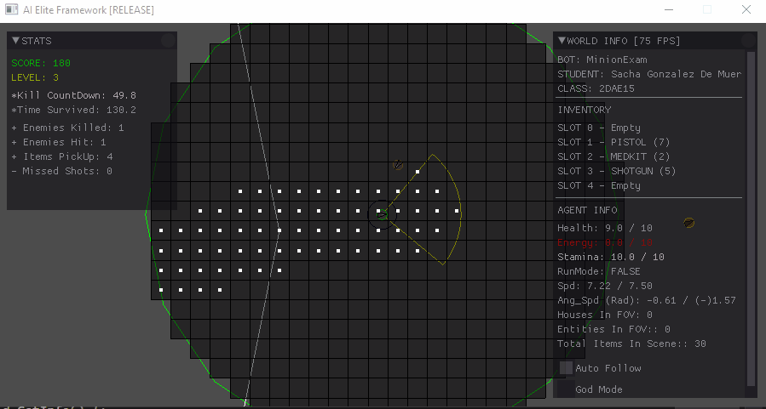
Enemy handling
Bite sets influence on map, alerting agent of danger
Agent looks around when danger is near
Enemy in fov => Lock&Shoot

Slide 4
Inventory
Inventory class
Tracks items in inventory Extended functionality for interface, ease of use.
Agent Memory – Influence Map
Nodes remember item type and position
Inventory management – Behavior Tree
-Inventory Management Selector: Garbage & Empty Items
-Survival Selector: Healing & Energy
-Looting Selector: Grab item, drop item when needed.

Slide 5
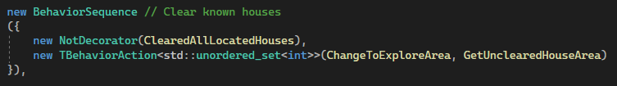
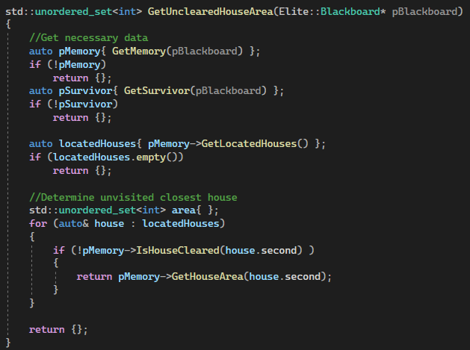
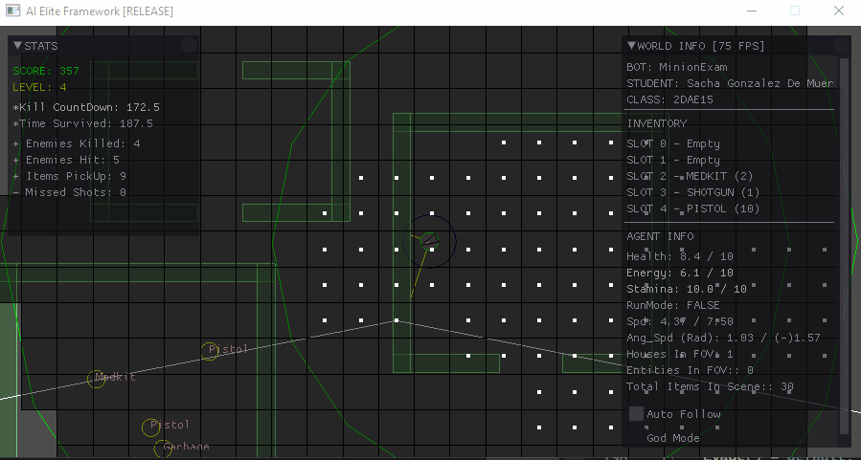
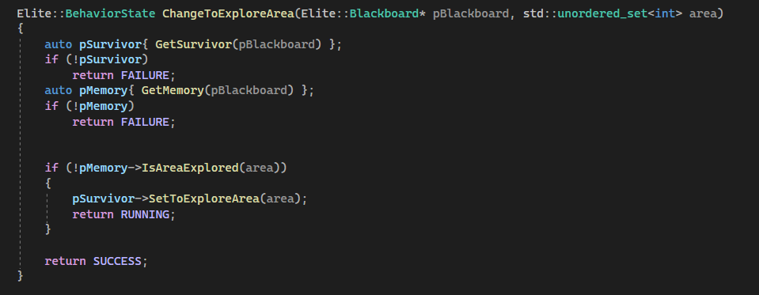
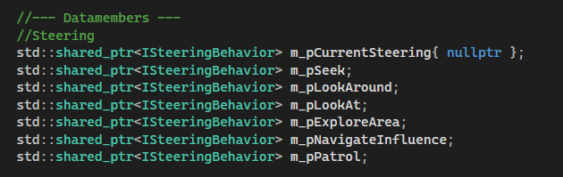
Movement & exploration
Exploration
-Circular Wander-Patrol -Area exploration -> Influence map

Slide 6
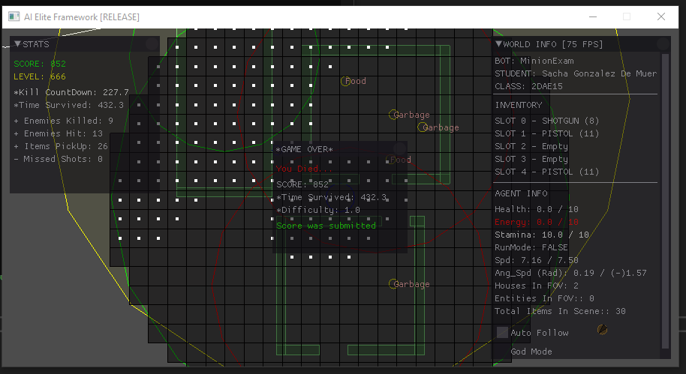
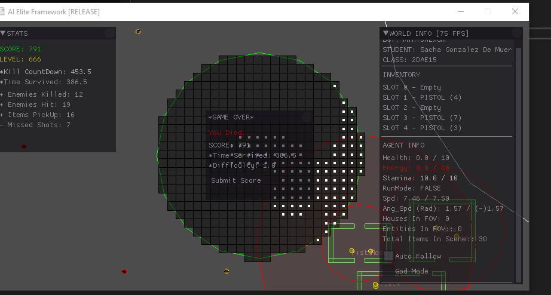
High Score

